Slide 1

Omnistudio Developer
Raja Vellayan
Prepared on 24/Jan/2022
My Certifications
BSS Tools – Vlocity / Omnistudio, Industries CPQ, OM, Admin, PD1
OSS Process & Tools – ITIL V3 MALC, ITIL 4 MP, ITSM, BMC Remedy
Management – Agile, PMP – PMI(currently Perusing)

Slide 2

Agenda
Prerequisites
Introduction
Vlocity Architecture Principles
Salesforce and Vlocity Metadata
Key Components of the Vlocity / Omnistudio Core Architecture
Vlocity / Omnistudio Data Model
Vlocity Cards, Flex Cards and OmniScripts
DataRaptors and Integration Procedures
Calculation Procedures and Matrices
IDX Workbench
Vlocity Industry Process Library and Data Packs

Slide 3
Prerequisites
While there are no formal prerequisites for this course, you have greater success if you have:
A solid understanding of basic Salesforce concepts and functionality
Completed the Admin Beginner, Intermediate, and Advanced Trails in Salesforce Trailhead, and preferably have Salesforce Administrator or Developer credentials
Completed the Build Lightning Web Components Trail in Trailhead.
Experience working with relational databases and familiarity with JSON
Other prerequisites, Complete the below course in Trailhead
https://trailhead.salesforce.com/en/users/auser797/trailmixes/build-guided-experiences-with-omni-studio-prework

Slide 4
Introduction (Overview and Intended Audience)
Overview
Discover how to develop engaging, digital-first guided experiences using OmniStudio tools. In this class, our OmniStudio experts will show you how to use FlexCards, OmniScripts, and the OmniStudio Interaction Console to configure applications that elevate the user experience. You’ll learn how to retrieve and transform internal and external data using declarative OmniStudio data tools to get a 360-degree view of customer accounts, empowering you to quickly deliver high-quality, consumer-grade experiences that your users expect.
Who should take this course?
This course is designed for platform developers, UI developers, solution architects, and technical architects who are responsible for the setup, configuration, or maintenance of OmniStudio applications or Salesforce Industry Cloud apps. This class is recommended for anyone looking to earn their Salesforce Certified OmniStudio Developer credential.
The training will happen in both Theoretical and Practical way via Demo and work assignments will be handed out at the end of each session to be completed by the participants before each next session.

Slide 5
Difference between OS Consultant and Developer
Omnistudio Consultant:
The Salesforce OmniStudio Consultant credential is intended for individuals who have experience consulting on building cloud applications using OmniStudio tools in a customer-facing role. Candidates able to explain the purpose of OmniStudio tools and can design solutions using OmniStudio tools that meet customer business requirements, are maintainable and scalable, and contribute to long-term customer success.
More Info
Omnistudio Developer:
The Salesforce OmniStudio Developer credential is intended for individuals who have knowledge, skills, and experience developing cloud applications using OmniStudio declarative development tools. The Certified OmniStudio Developer is able to design and configure applications using OmniStudio tools, including FlexCards, OmniScripts, Integration Procedures, DataRaptors, Calculation Procedures and Matrices, and Industry Consoles.
More Info

Slide 6
Course Target - Goal
When you complete this course, you’ll be able to:
Create FlexCards and build an OmniStudio Interaction Console to improve customer experience.
Create OmniScripts to ensure productive, consistent user engagement.
Use Integration Procedures to execute complex operations on the server and incorporate external data sources.
Create and modify DataRaptors to get data from Salesforce, transform data, and save data back to Salesforce.
Create Calculation Matrices and Calculation Procedures to execute data lookups and calculations.
Migrate Omnistudio components from one environment to another using IDX Workbench.
Request your first Omnistudio Org from the below link,
https://trailhead.salesforce.com/en/promo/orgs/omnistudiotrails
https://vlocitytrial-prod.herokuapp.com/?templateid=SFI_IPQ (for Omnistudio, CPQ and OM)

Slide 7
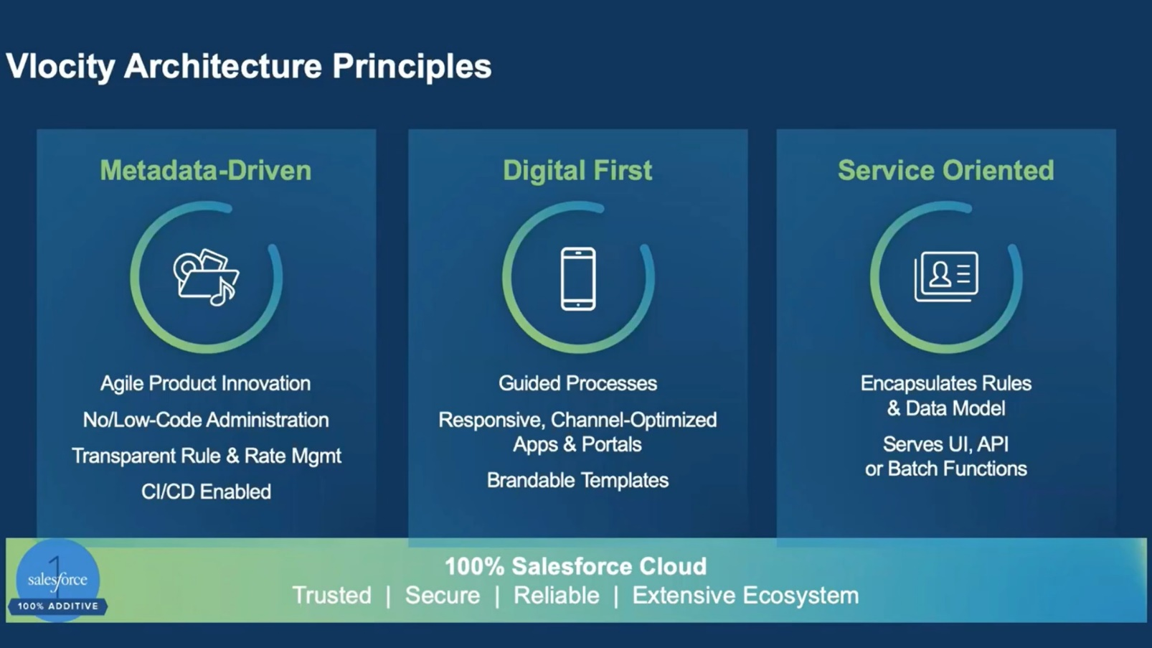
Vlocity Architecture Principles
It's metadata driven
It's digital first
It's service-oriented
It runs on the Salesforce Platform and is 100% native and additive to Salesforce
Notes:
An overview of the Vlocity application architecture, covering the following:
The principles that drive the architectural design.
How the components within the architecture fit together and how the product is structured and layered.
The specific capabilities of the Omnistudio architecture that extend Salesforce, and how Salesforce and Omnistudio fit together.

Slide 8
Vlocity Architecture Principles (Cont..)
Metadata-driven Architecture.
The whole vlocity system is configurable.
100% driven by configuration (No / Low Code)
Optimized, configurable, and brandable across different channels.
Access to business process via a phone or a portal underlying on single configuration.
Vlocity services are callable from third party services.
Ability to connect with client tools.
Integration via API access.
The Vlocity solution inherits the performance, security, and manageability of the Salesforce platform.
Data is secure inside of Salesforce.
Vlocity is relevant with Salesforce skills.
Notes:
The Vlocity solution is configurable.
The architecture is metadata-driven, which means it's configurable. Designing our product to be 100% driven by configuration ensures it can match a specific customer scenario.
Everything is driven through configuration, from defining the product, to administering the system, to setting up business processes.
Optimized, configurable, and brandable across different channels.
We designed Vlocity keeping in mind how our customers and partners access the systems and processes through different channels.
An end consumer or business partner can access a business process from a phone or a portal and continue that process calling in to a call center.
Vlocity services are callable from third party services.
Vlocity's core capabilities are wrapped in API access. This allows simple functions to be combined to be more complex and configurable.
With a service-oriented architecture, a customer that built their own UI component can easily tie it back to Vlocity.
The Vlocity solution inherits the performance, security, and manageability of the Salesforce platform.
Vlocity is 100% native and additive to Salesforce, which means that data is secure inside of Salesforce. It also means that your Salesforce skills, as well as your know-how extending Salesforce, are relevant with Vlocity.

Slide 9
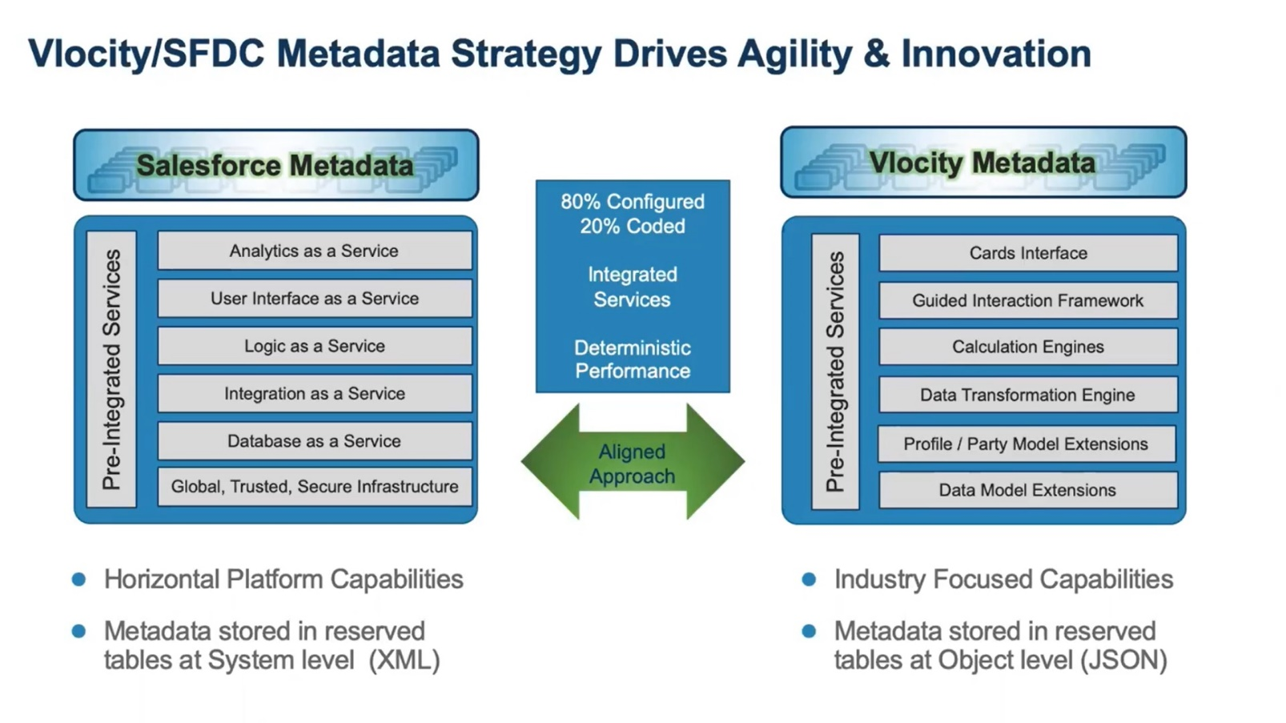
Salesforce and Vlocity Metadata
From Fall 22 version Omnistudio runs in parallel with salesforce.
Salesforce is pre-integrated and configurable.
80% Configured - 20% Coded.
Vlocity solves complex industry challenges with pre built solutions.
Notes:
In the different industries that Vlocity serves, Vlocity adds a set of configurable application services on top of Salesforce. This enables you to solve complex vertical industry challenges with little or no coding.
Salesforce is a set of application services that are all pre-integrated and configurable. When setting up Salesforce, it's best to do so looking at a specific business problem and configuring each Salesforce service to match to the business problem.
A really good Salesforce solution is mostly configurable, with the option of overriding a service with your own code to do something specific. Typically, this is an 80/20 arrangement, where 80% of the solution is configured and 20% is coded.
What happens if you use Salesforce in a complex industry setting?
To solve vertical industry challenges, Vlocity adds a set of configurable application services on top of Salesforce, restoring that "mostly" configured platform when considering a complex vertical business solution.

Slide 10
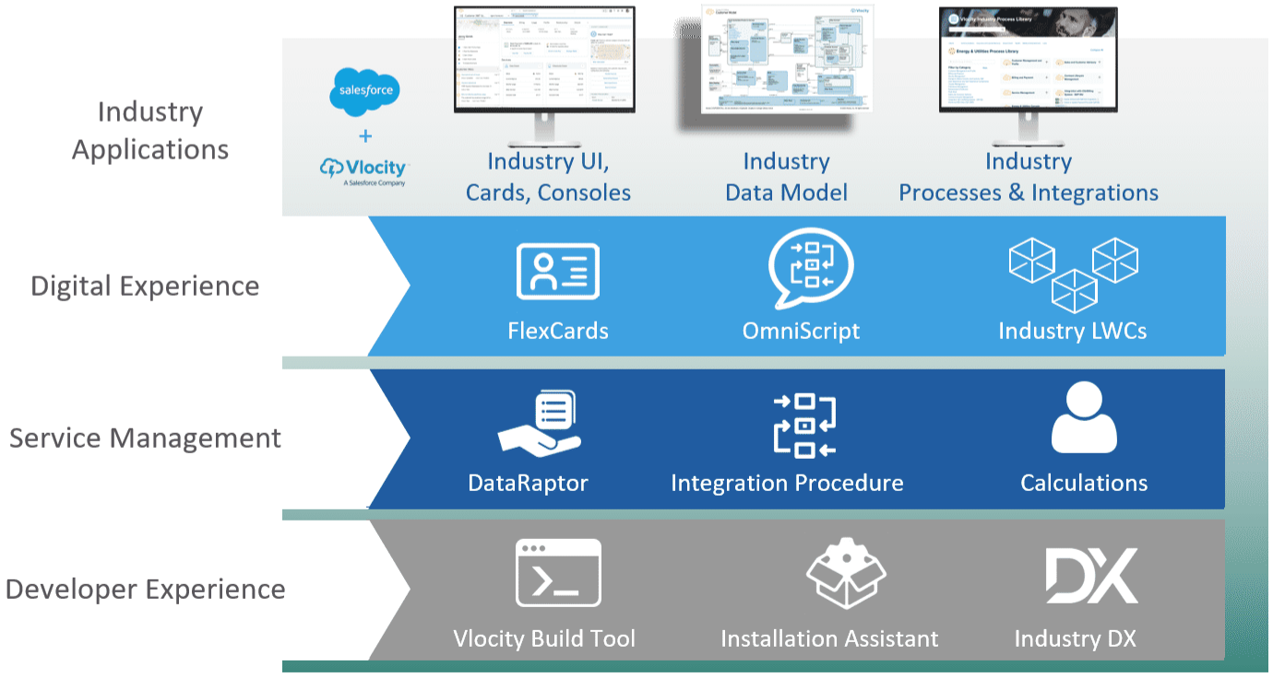
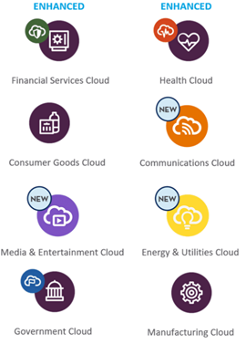
Omnistudio Core Architecture
Industry Applications
Notes:
Industry Applications
We build Industry applications on the combination of Salesforce with Vlocity and other industry extensions. We provide you with industry processes and integrations out of the box that you can deploy as is or configure to requirements using our tooling. This layer includes industry-specific UIs such as industry consoles, which are built using the Salesforce Lightning App Builder. These industry apps are built on an underlying industry-specific data model.
The Vlocity Industry Process Library is a collection of pre-built, industry-specific process components where you customize your business needs without writing code. Process components are organized by industry.
Digital Experience
The Digital Experience layer includes two primary UI components: FlexCards and OmniScripts. They are built on Salesforce Lightning Web Components (LWCs).
FlexCards (a new generation of Vlocity Cards) and Vlocity OmniScript are declarative tools that provide rich user interaction experiences that are understandable by humans.
Service Management
The Service Management layer combines data from within and outside of Salesforce into integrated experiences. This layer includes two primary data services: DataRaptors and integration Procedures. It also includes tools for processing complex calculations.
Integration Procedures and DataRaptors deliver data to and from our UI components. They orchestrate calls to the industry apex classes, calculation engines, and external APIs to execute whatever business logic is required by the process.
Note: Using these declarative tools speeds up your development time and makes it more cost-effective to maintain updates over time. For example, if you want to expose a new field that's providing a new piece of information in a UI or in a process, you can simply add it into the DataRaptor and Integration Procedure to expose it, then add the field in a FlexCard to show it to your user.
Developer Experience
We provide tools for developers to source control and quickly deploy functionality in multi-org, multi configurator/ developer environments typical of enterprises.
The Vlocity Build Tool is a command line automation tool that automates a continuous build process for Vlocity configuration artifacts. It's an open-source GitHub project that is source-control friendly.
Industry IDX Workbench enables development teams to check Vlocity Components in and out of source control, visualize version-to-version changes, and migrate changes and dependencies between orgs.

Slide 11
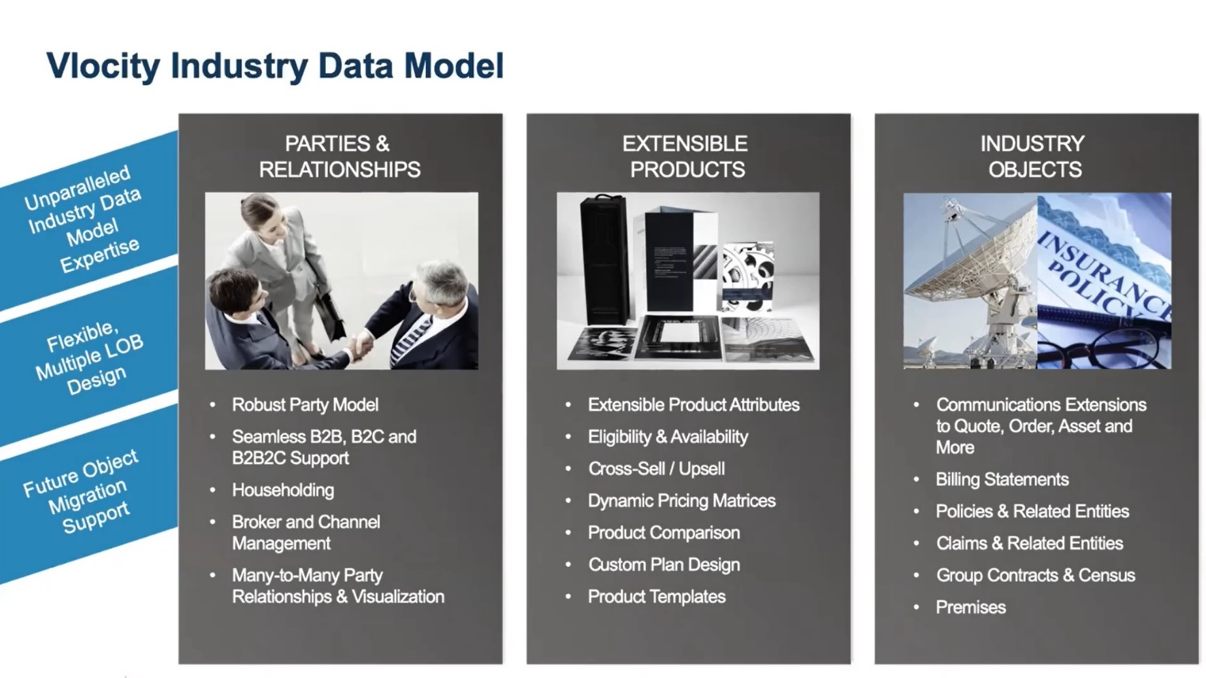
Vlocity Data Model
Notes:
Vlocity extends the core Salesforce data model in a number of different areas. We store everything we need to store for our vertical applications in core Salesforce objects. After we've fully utilized these core objects, we then add additional objects through Salesforce's custom objects framework.
When our customers add Vlocity to Salesforce, it doesn't change how the custom objects they've built behave. Think of Vlocity as adding a layer of extra objects to Salesforce to store industry information. It's in a set of three different buckets.
Parties & Relationships
Different industries have different go-to-market strategies. Often other parties are involved in the sales and servicing of products.
Vlocity has added data objects to Salesforce to house the information describing those third-party entities, as well as the relevant transactional information in their business flows.
Intermediary examples: Insurance brokers and agents (insurance space) and retail stores (communication space).
Industry Objects
Vlocity has added industry objects to represent the different industries. Each industry has a set of objects that map to the industry.
Extensible Products
Extensible Products help end-users make product selection and also help with product attributes
and other details that drive pricing.
Vlocity has extended the product model within Salesforce to make it more end-user friendly, as well as friendly to the rating, pricing, and quoting of these complex pricing transactions.
Vlocity has added a capability called Product Attribute Categories and Product Attributes that allow you to go into more detail to describe the product.

Slide 12
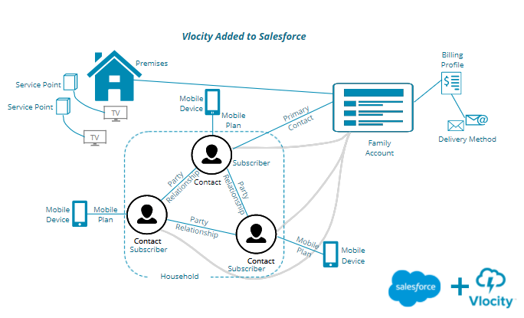
Vlocity Data Model
Let's say you have an account that is a family plan for mobile service. Everyone in the family has a mobile device, with different usage amounts. Then there's the cable TV for two different televisions. If all this is from the same company, you expect to just pay one bill. Let's look at how Vlocity's custom objects and fields accommodate that.

Slide 13
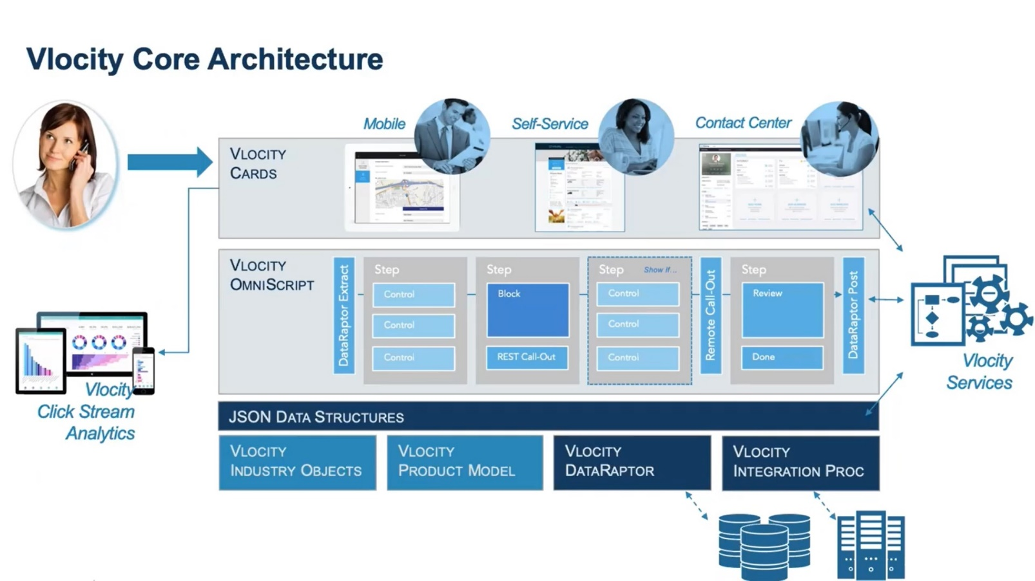
Key Components of the Vlocity Core Architecture
Three Tier Application Stack.
User Interface, Business Process and Data.
Vlocity Cards and OmniScripts are End user facing components.

Slide 14
Key Components of the Omnistudio Core Architecture (Cont..)
Vlocity / Flex Cards (The User Interface Component)
Contains powerful set of configurable UI components to solve complex business challenges.
Card frameworks are omni channel – easy to deploy and reuse.
OmniScript (Guided Interaction Layer)
Help human guide through set of Business process.
Data Tools
Two key components - DataRaptor and Integration Procedures.
DataRaptor is a tool for pushing and pulling complex, hierarchical data in and out of Salesforce.
Integration Procedure is the building block that can be combined into a set of server-side configurable processes.
Vlocity Services – Provides Industry specific Services.
Vlocity Click Stream Analytics – Collects informational data and feeds during business process into analytic tools such as Salesforce Rave.
Notes:
Vlocity / Flex Cards (The UI)
Cards extends core Salesforce with a highly configurable set of UI components, as opposed to having to write code to get complex UI interactions.
These powerful, general purpose set of UI components solve complex UI challenges specific to the industries that Omnistudio serves.
OmniScript (Guided Interaction)
OmniScript is designed to guide a human through a set of business processes. It optimizes the user experience of a person walking through a business process.
Data Tools
Omnistudio has a lot of extensions to the Salesforce data model, extending it with industry objects. Two key components which aid in integrating Salesforce into third party systems are DataRaptor and Integration Procedures.
DataRaptor is a tool for pushing and pulling complex, hierarchical data into Salesforce. It is the building block that can be combined into a set of server-side configurable processes using what is called an integration procedure.
Vlocity Services and Vlocity Click Stream Analytics
The Vlocity core architecture is a foundation for all of the different industry applications that Vlocity builds. Each industry has a set of services that are industry-specific.
Vlocity has a strong digital layer, which adds a whole set of monitoring and instrumentation around UI events. As users transition through business processes, we capture all that data and feed analytic tools such as Salesforce Wave at the business process level.

Slide 15
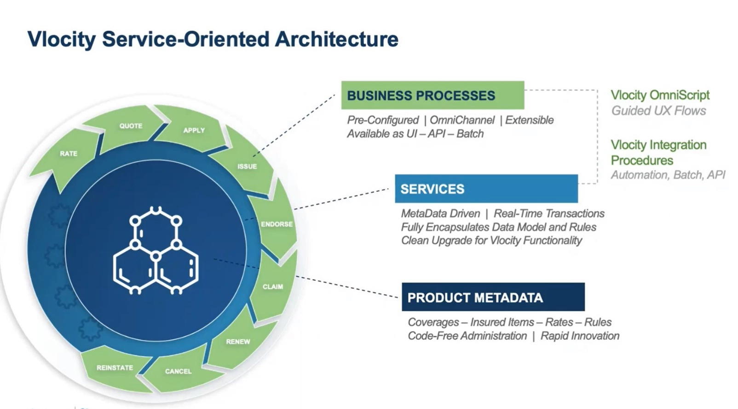
Vlocity Service-Oriented Architecture
Notes:
The Vlocity Architecture is service-oriented.
Product information is configured through metadata. The definition of products is defined through configurations. The digital layer associate’s business processes with the product, for example, what the end user is doing, whether it's quoting on a product or enrolling, etc.
Services are what do the work (such as calculations, data retrieval and data movement) to connect the core product information with the business process that an end-user sees. They are the "glue" that hooks the business processes together with core product information.

Slide 16
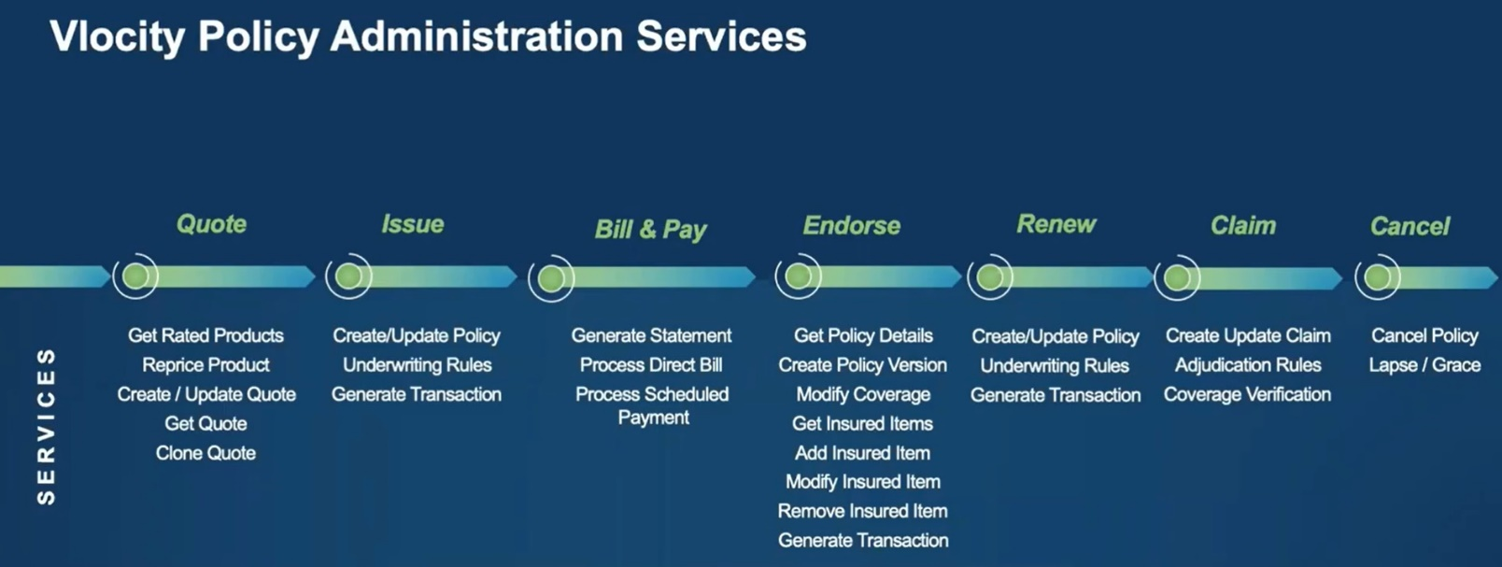
Vlocity Service-Oriented Architecture (Cont..)
Notes:
Services are generally organized by different points along a customer lifecycle. Each industry has a set of purpose-built services. We take these and bind that business process to the product or customer information, which allows us to combine it all into more complex features.
This image shows a set of Policy Administration Services relevant for insurance.

Slide 17
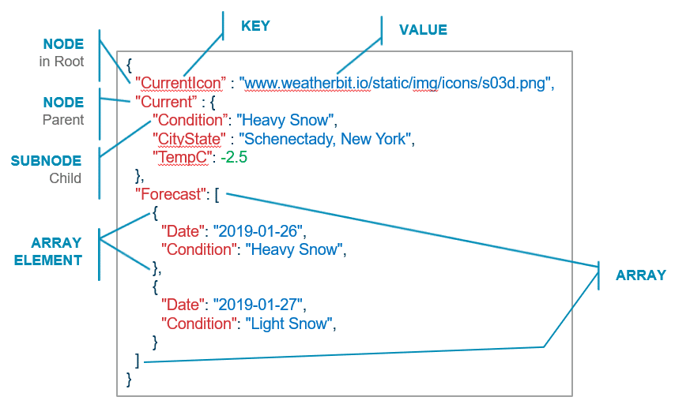
JSON Structure
What is JSON?
Stands for JavaScript Object Notation
Is a lightweight data interchange format used to transfer data over a network
Is easy for:
Humans to read and write
Machines to parse and generate
All data native to Vlocity moves around as JSON
Notes:
JSON Nodes and Subnodes - A collection of name/value pairs, usually in a hierarchy
In the image above, the "Date" and "Condition" fields are subnodes nested under the "Forecast" node. In Vlocity, JSON data is often built using this node/subnode hierarchy.
Subnodes are set between curly brackets (also called curly braces) after the parent node. You can use the name of the parent node to call all of the data in its subnodes. For example, when you call the "Current" node, all three of its subnodes are returned.
JSON Array - An ordered list of values. Notice the square brackets enclose the entire array. Each set of items is enclosed by curly brackets, and contains the same field names.

Slide 18
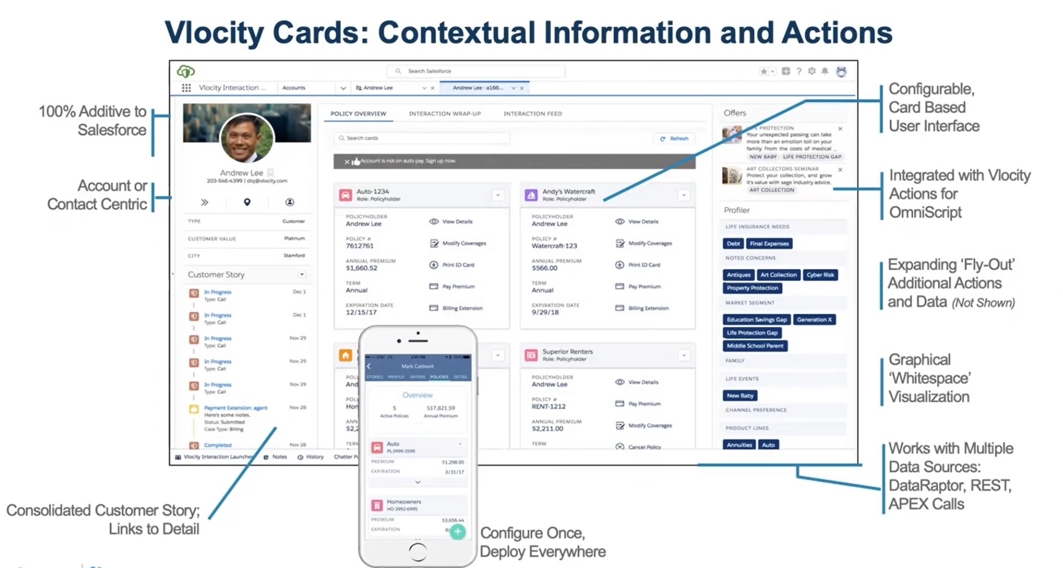
Vlocity Cards
Notes:
Vlocity cards – used to display objects and related objects. Eg) Insurance call centre display card shown above.
The data lives off platform as per policy administration system. So, customer information sits on master data management system at the backend.

Slide 19
Flex Card Designer
Header (1), Canvas (2), Build panel (3), Properties panel (4), Style panel (5), Setup panel (6), Preview (7), In-Product Help (8), Publish Options (9)
Notes:
FlexCards Basics – FlexCards provide tools for building customer-centric, industry-specific UI components and applications on the Salesforce platform. FlexCards are rich in information and actions relevant to the customer's context. Create your FlexCards in a declarative design tool and add them to your Lightning or Community pages.
Customer Context – Each customer is linked to multiple aspects of your company's products and services. Customers have accounts, preferred methods to receive bills, preferred means of contact, and a history of the products they have purchased as well as their interactions with the company. When agents must use different systems to gather contextual information about the customer, it affects customer service. Use FlexCards to streamline customer engagement.
Designer – The FlexCard Designer is a declarative tool to create UI components. Build dynamic customer-centric UIs without code from a drag interface with WYSIWYG editing.
FlexCard Designer Highlights
With the FlexCard Designer, you can:
Build your FlexCard on a wide and adjustable Canvas.
Drag customizable elements from the Build panel onto the Canvas.
Adjust the width of any element along a 12-column horizontal grid.
Use the Action element to launch an OmniScript or Flyout, and trigger Custom or Pubsub Events, and more.
From the Style panel, customize the look and feel of your FlexCard. Style elements using a GUI to choose the colors of texts, borders, and backgrounds, change the size of fonts and entire elements, and make elements responsive.
Create a new FlexCard and configure your data source with a step-through wizard.
Use In-Product Help to learn about a property or an element without leaving the Designer.
Configure FlexCard-wide settings from the Setup panel, such as required permissions, event listeners, session variables, and more.
Configure metadata values for your generated LWC and update its component SVG icon with the Publish Options feature.
Download on and off-platform FlexCard LWCs.
Debug your FlexCard by viewing its data JSON and the response and request logs for its actions and events.
Run FlexCards outside of Salesforce with OmniOut for FlexCards.

Slide 20
Flex Cards (Cont..)
FlexCard Naming Conventions
Follow requirements when naming FlexCards and FlexCard elements to prevent errors when working with the FlexCard Designer and importing FlexCards as datapacks. For example, you may run into issues when importing a FlexCard with the same name as one that already exists in your org.
FlexCard Naming Requirements
Requirements | Examples
The combination of the card Name and Author must be unique in your Org. For example, if importing a FlexCard with the same name and author of a current FlexCard, you will be asked if you want overwrite the current FlexCard in your org. | Name = AccountActive, Author = CustomerSales
The name and author must only contain underscores and alphanumeric characters. It must be unique, begin with a letter, not include spaces, not end with an underscore, and not contain two consecutive underscores. | Not acceptable: account$card! 2account__card $$account__card_ account card
If you have multiple versions of a FlexCard, only one version can be active at a time. | N/A
FlexCard names cannot be changed. You must clone a FlexCard to change the name. | N/A

Slide 21
Flex Cards (Cont..)
FlexCard Element Name Requirements
Requirement | Examples
Element Names cannot contain spaces and must be unique in a FlexCard. It can contain any string combination of alphanumerical and special characters. | Acceptable: Not acceptable: address_block address block View_Account View Account $account_revenue! $account revenue!

Slide 22
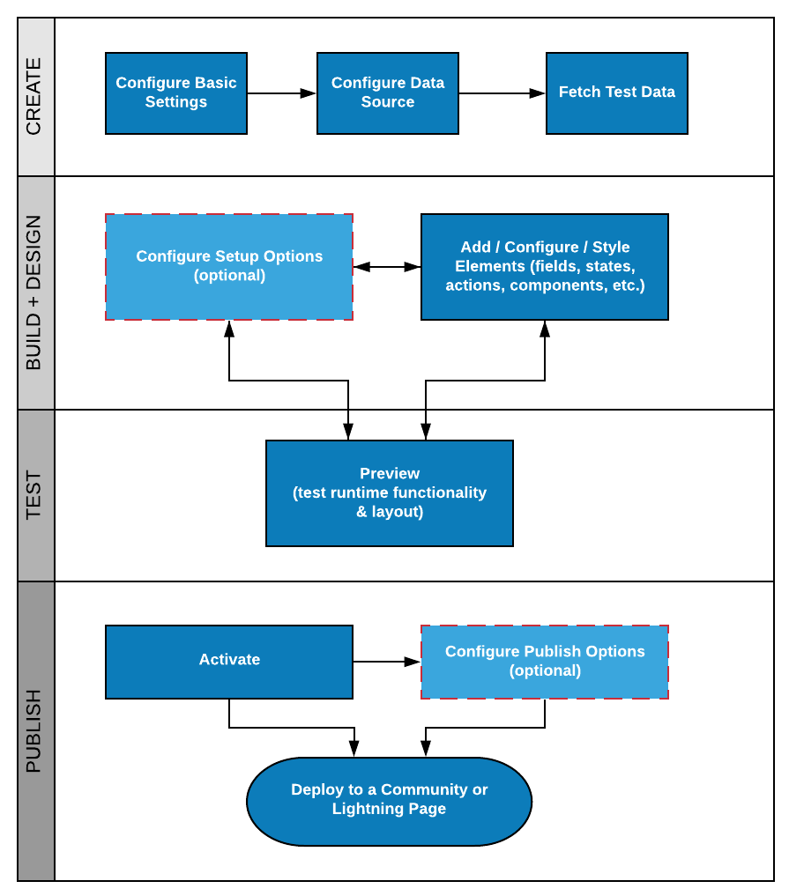
Flex Cards (Cont..)
Notes:
FlexCards
A FlexCard is a block that contains a combination of pertinent information and links to processes within a specific context. For example, an account card can include unique account information, such as:
Status
Priority or service level agreement
Creation date
Actions on an account card might include:
Closing a case
Opening a new case
Creating a new task
In the FlexCard Designer, you can create an action that launches or updates an OmniScript, navigates to a web page or application, displays a flyout, fires an event, update field values, and more.
Design and Layout – Style individual elements or add custom CSS directly on an element within the FlexCard Designer. You can also make elements responsive.
Data Sources – Select from multiple data source options to retrieve data to display on your FlexCards.

Slide 23
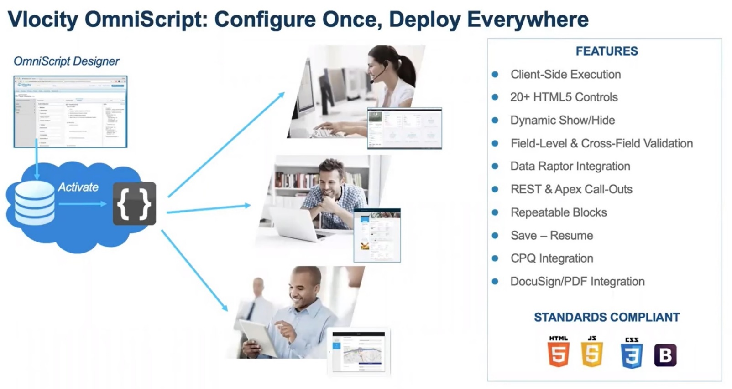
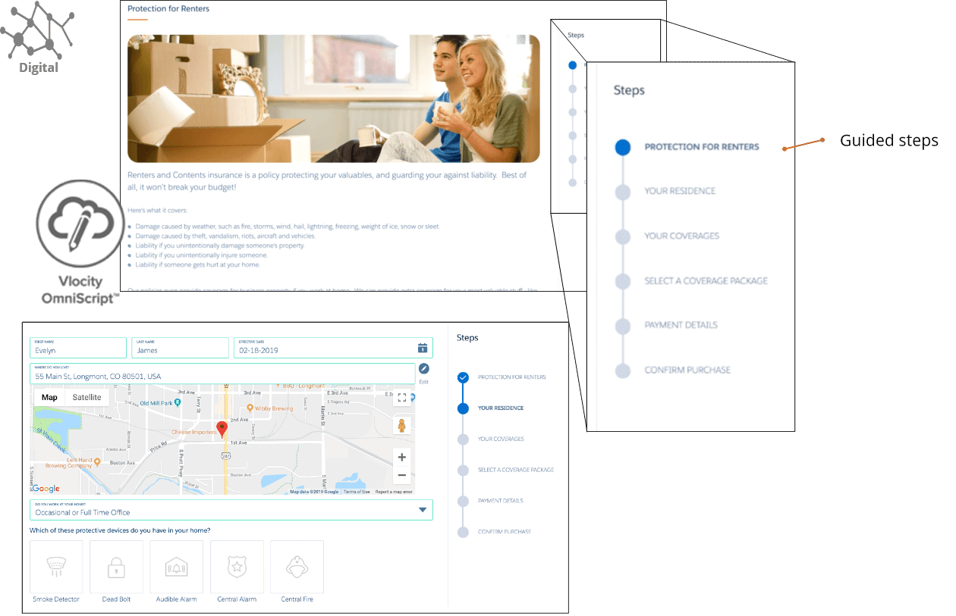
OmniScripts
Notes:
An OmniScript is an omnichannel customer engagement and a business tool built on the Salesforce platform. OmniScripts allow you to craft dynamic customer interactions without code and deploy to multiple channels and devices. Administrators can define a script once and then deploy the script within a Salesforce application or on a web page. Create OmniScripts to guide users through sales and service processes with fast, personalized responses, and seamless integration to enterprise applications and data.
OmniScript is a guided interaction platform that takes humans through complex business processes.
Using drag and drop OmniScript Designer tool, we can design an interactive business process on screen, deploy it, and then view it on any channel.
Eg) Using OmniScript Designer tool, we can pull in business process steps, input elements, output elements, calculations steps, data API calls to external systems.
The same business process has a version that appears for an end user in a portal, and has another version with more unlocked capabilities that displays for a call centre agent, and it can also be deployed to a tablet or phone.
Behind the scenes, the OmniScript Designer builds up a metadata definition of what the business process looks like. The business process itself runs in the client in a JavaScript framework, meaning it is a highly responsive framework and reduces the number of API calls back to Salesforce.
OmniScript Basics
A OmniScript guides users through complex processes with fast, personalized, and consistent responses. For example, you can create an OmniScript to guide:
A customer service agent to add a new customer
An insurance agent to update a policy
An end user to complete a self-service interaction such as troubleshooting
You can create a guided interaction to match the flow of your process. OmniScript is a declarative scripting tool, meaning you create it with clicks, not code. To create the structure of an OmniScript, you drag and drop different types of elements to:
Add actions such as extract data or send an email
Group items together by creating a step or displaying a list of items the customer can select from
Create a function such as a formula
Add input fields and lookups for the user to enter data
Refine the display by using a headline or text block
Create branches that dynamically adjust the controls and enable or disable steps depending on choices the user makes in the guided process
Configure calculations and messages that provide immediate feedback and error checking to the user
Templates control both the style and appearance of OmniScripts. You can customize whether your guided interaction has a horizontal or vertical mode, branding, and any other aspects you wish to change.
You can launch an OmniScript from anywhere, including:
An action button such as the one shown here on the account page
An action link on a card

Slide 24
OmniScripts Best Practices
Business Process and Logic
Use one owner for each OmniScript.
Identify reusable elements by building a skeleton of the entire OmniScript.
Document the purpose of an element in the element's Internal Notes property.
Maintain DataRaptors and Apex classes by avoiding element name changes. If the element name must be updated, apply the name changes to the DataRaptor or Apex class.
Avoid assigning a ContextId within the OmniScript. OmniScript's ContextId is a reserved key that assigns a Record Id from the URL.
When processes are repeatable across multiple OmniScripts, create a reusable OmniScript, and add it to the appropriate parent OmniScripts.
User Experience Design Principles
Reduce the number of fields the user must input information into by prefilling the fields using contextual data.
Avoid confusing the user by breaking processes up into shorter steps that contain a minimal amount of elements.
Guide the user by creating contextual help text and logically ordering input fields.

Slide 25
OmniScripts Best Practices
Performance Factors - A set of best practices exists for both Client-side performance and Server-side performance.
Client-side best practices include:
Reduce Conditional Views, Merge Fields, Formulas where possible.
Speed up the application of responses by trimming the Response JSON.
Remove spaces from element names to improve the OmniScript's load time.
Reduce the number of elements in the script. A single OmniScript should not exceed 200 elements.
Run logic on the server where possible, including conditional logic in Integration Procedures and formulas in DataRaptors.
Test performance by enabling time tracking. If time tracking is not used in production, disable the feature before deploying to production.
Server-side best practices include:
Cut down the payload size of a request by trimming the JSON request.
Reduce server roundtrips by using Integration Procedures whenever multiple actions run between steps. Run Integration Procedures asynchronously by enabling the fire and forget property.
Remove unnecessary data by trimming the DataRaptor extract output.

Slide 26
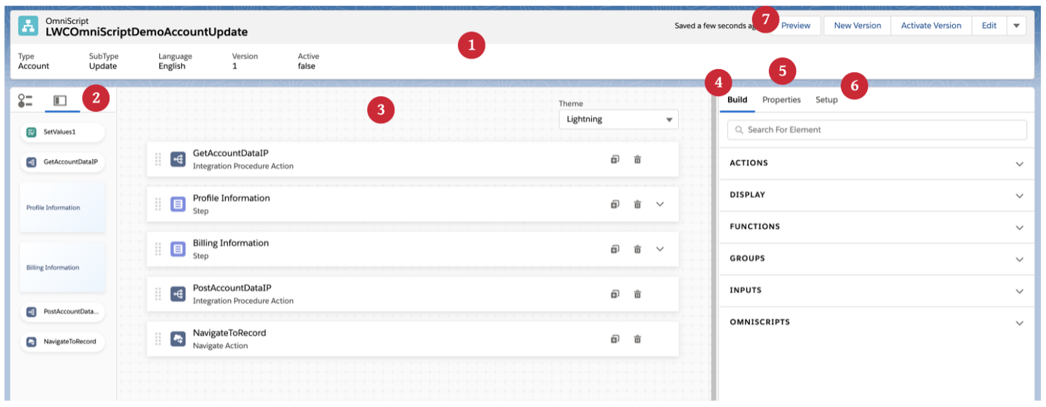
OmniScripts (Cont..)
Header (1), Navigation Panel (2), Canvas (3), Build panel (4), Properties panel (5), Setup panel (6), Preview (7)
Notes:
OmniScript Designer Highlights
Notable features of the OmniScript Designer include:
Building your scripts on a wide and adjustable Canvas and instantly view changes made to element properties.
Repositioning, cloning, and adjusting the width of step elements along a 12-column horizontal grid.
Accessing inactive elements and navigating between elements in high-level and detailed views from the Navigation Panel.
Configuring elements from the Properties panel.
Searching for and dragging elements onto the Canvas from the Build panel.
Configuring script-wide settings from the Setup panel.
Viewing contextual In-Product Help to discover and learn about elements and properties without leaving your script.
Previewing, testing, and debugging your script in Preview.

Slide 27
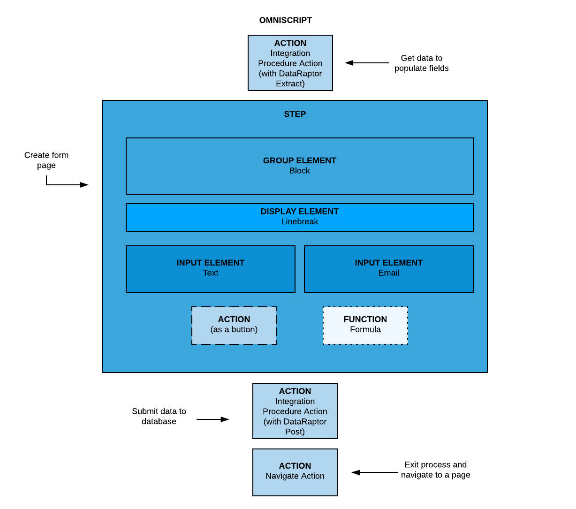
OmniScripts (Cont..)
Notes:
OmniScript Design Considerations
Two key design tenants
It's all about the user experience! There is high fidelity control on how that digital experience for the end user works.
OmniScript has been carefully crafted to manage the underlying data payload that drives pricing, configuration, and product selection, also known as CPQ.

Slide 28
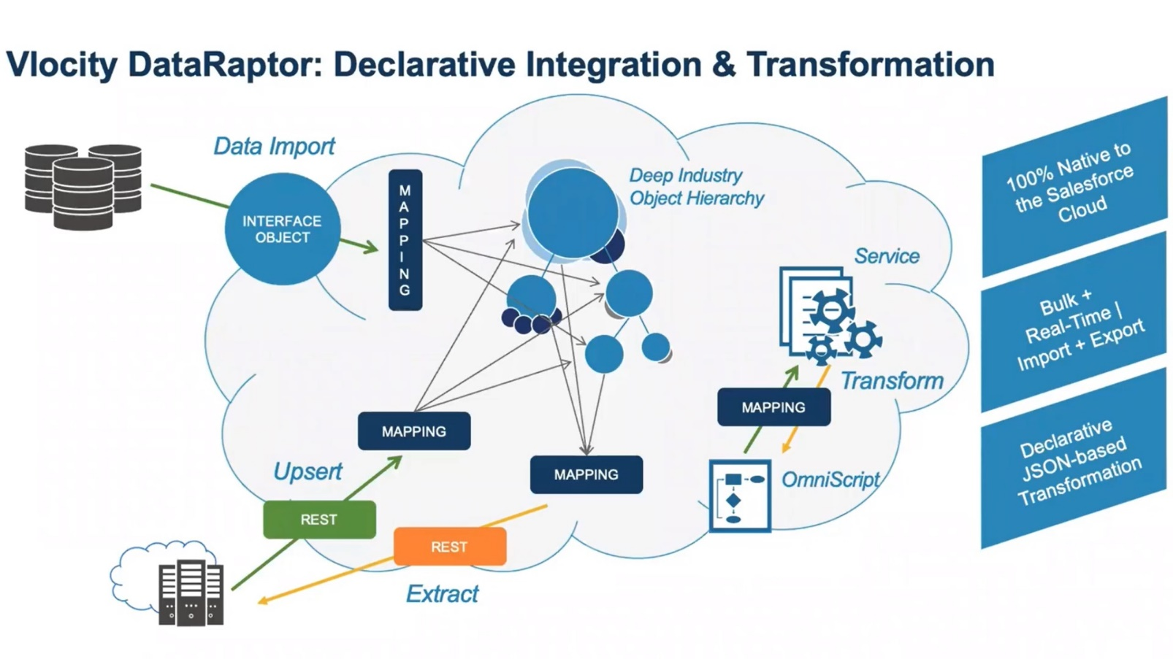
DataRaptors
Notes:
DataRaptors
A big part of working with vertical data models and complex vertical applications is moving data into and out of Salesforce and between Salesforce related systems. When doing this we must be aware of the relationships between the Salesforce objects and these data mappings.
We accomplish this using Vlocity DataRaptor, which is a configurable data transformation engine.
Vlocity DataRaptor can do the following:
Take arbitrary, hierarchical data structured in JSON and push it into Salesforce, as well as take care of all of the data references (pointers).
Take data that's in a hierarchical structure inside of Salesforce and change how it is structured: where the parent/child relationships are, flatten objects, change and map nodes, and extract it as a JSON object.
Transform data, one of the most common uses. When building out a Salesforce application, the translation from what the API is to how it needs to be presented in the UI layer is done through code. Because DataRaptor can do transforms with a configured mapping, all of that apex code can be turned into a straightforward configuration in DataRaptor.
Treat bulk import like an upsert where, instead of having a JSON object, there is a wide record that represents the fields that need to get pushed into a hierarchical object inside of Salesforce.

Slide 29
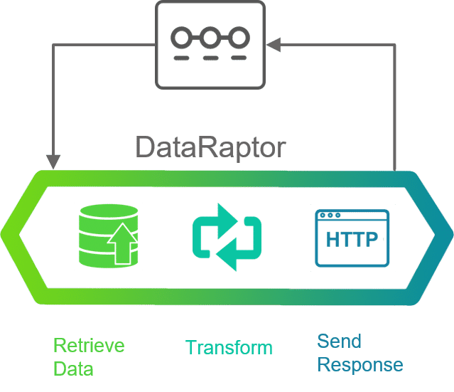
Omnistudio DataRaptors
A DataRaptor is a mapping tool that enables you to read, transform, and write Salesforce data. There are four types of DataRaptor: Turbo Extract, Extract, Transform, and Load.
Turbo Extract: Read data from a single Salesforce object type, with support for fields from related objects. Then select the fields to include. Formulas and complex field mappings aren’t supported.
Extract: Read data from Salesforce objects and output JSON or XML with complex field mappings. Formulas are supported.
Transform: Perform intermediate data transformations without reading from or writing to Salesforce. Formulas are supported.
Load: Update Salesforce data from JSON or XML input. Formulas are supported.
DataRaptors typically supply data to OmniScripts, Integration Procedures, and Cards, and write updates from OmniScripts, Integration Procedures, and Cards to Salesforce. A typical data flow is as follows:
OmniScript calls DataRaptor Extract to read data from Salesforce.
OmniScript interacts with user to capture changed and new data.
OmniScript calls DataRaptor Load to write data back to Salesforce.
Note: Both Extract and Load DataRaptors can handle custom data formats. DataRaptors can access external objects and custom metadata as well as sObjects. No special syntax or additional configuration is required.

Slide 30
DataRaptors Best Practices
To maximize the benefits of DataRaptors, follow the best practices whenever possible.
Create targeted DataRaptors that only extract or load the data needed for one operation.
Use relationship notation (queries) whenever possible to pull data from other SObjects.
Try to keep the number of SObjects to three or fewer.
Ensure that all filtering and sorting (ORDER BY) operations are on indexed fields. The Id and Name fields are always indexed.
Use caching to store frequently accessed, infrequently updated data.

Slide 31
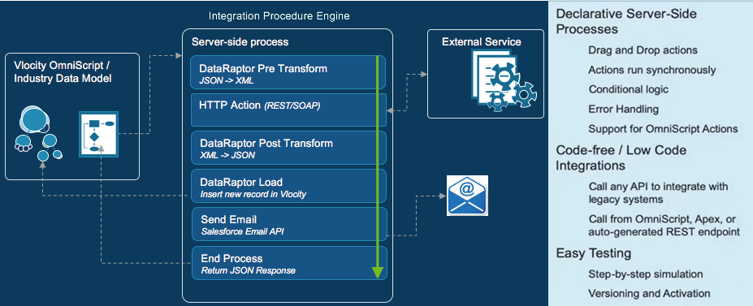
Integration Procedures
Notes:
OmniStudio Integration Procedures
OmniStudio Integration Procedures are declarative, server-side processes that execute multiple actions in a single server call. Integration procedures can read and write data from Salesforce and from external systems (using REST calls) and can call Apex code. An Integration Procedure can be called from an OmniScript, an API, or an Apex method, and can be a data source for a FlexCard.
Integration Procedures are optimal when you need to access and transform data from third-party sources and no user interaction is required, and moving the workload from client to server is desirable.
Integration Procedures can do some things that OmniScripts can't, the most important of which is list processing with Loop Blocks and List Actions. Integration Procedures can perform more data processing steps than DataRaptors can, and they're more flexible than Calculation Procedures.
Use Integration Procedures when you want to do more than a single step unlike DataRaptor. For example, when you do API calls, you want multiple steps and processes hooked together. This is an example of a multi-step process using DataRaptor and Integration Procedures.

Slide 32
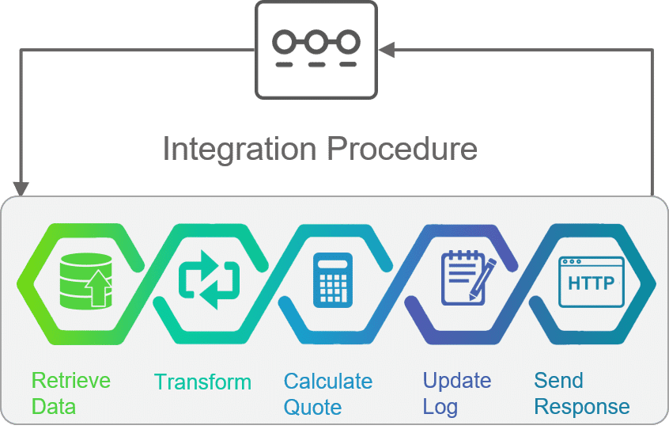
Omnistudio Integration Procedures
Vlocity Integration Procedures are declarative, server-side processes that execute multiple actions in a single server call. They are a way to get, save, and manipulate data behind the scenes. An Integration Procedure is the recommended tool to use as a best practice when you need fast processing of complex data from multiple sources. Here's the reasons why:
Server-side processing enables faster performance, as in most cases, the server is faster than the client at processing data.
Combining multiple actions in a single server call prevents round trips to the server. Minimizing client/server calls is beneficial, as more round trips mean slower performance.

Slide 33
Integration Procedures Best Practices
To maximize the benefits of Integration Procedures, follow the best practices whenever possible.
Use Integration Procedures for all data calls to Salesforce.
Use a Response Action for Integration Procedures to trim the data and only return what is needed. For specific trimming strategies.
Use multiple Response Actions with different Execution Conditional Formulas to allow an Integration Procedure to exit early under appropriate conditions.
Use caching to store frequently accessed, infrequently updated data.
To run data operations asynchronously, call Integration Procedures using these settings:
Use Future — Use when the calling OmniScript or Integration Procedure doesn't need a response and completion time is not critical.
Invoke Mode: Fire and Forget — Use instead of Use Future when the calling OmniScript must invoke the Integration Procedure immediately.
Invoke Mode: Non-Blocking — Use to run the Integration Procedure immediately while continuing the user interaction of the calling OmniScript. A response is returned when the Integration Procedure is complete.

Slide 34
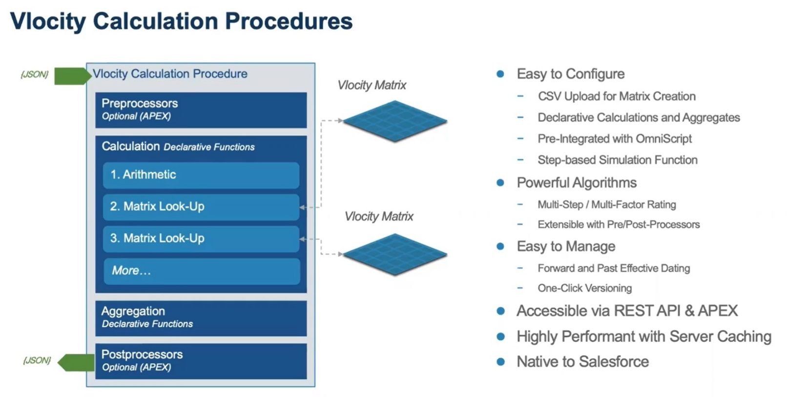
Calculation Procedures
Notes:
Calculation Procedures is a highly configurable service, a mechanism typically used for pricing. Calculation Procedures allow complex math to be configured procedurally on top of the Salesforce platform. You can run a detailed set of mathematical processing steps to do the kinds of calculations required in industries where more than a simple mathematical function is required. When there are a number of factors, values, and calculations, a calculation procedure can call one or more calculation matrices (which are lookup tables).
Calculation Procedures is another example of the metadata configurable capabilities of Vlocity. Instead of having to write a lot of code, you can hook together a series of sequential calculation steps (including pricing lookups and matrix lookups) to take a set of inputs and give an output.

Slide 35
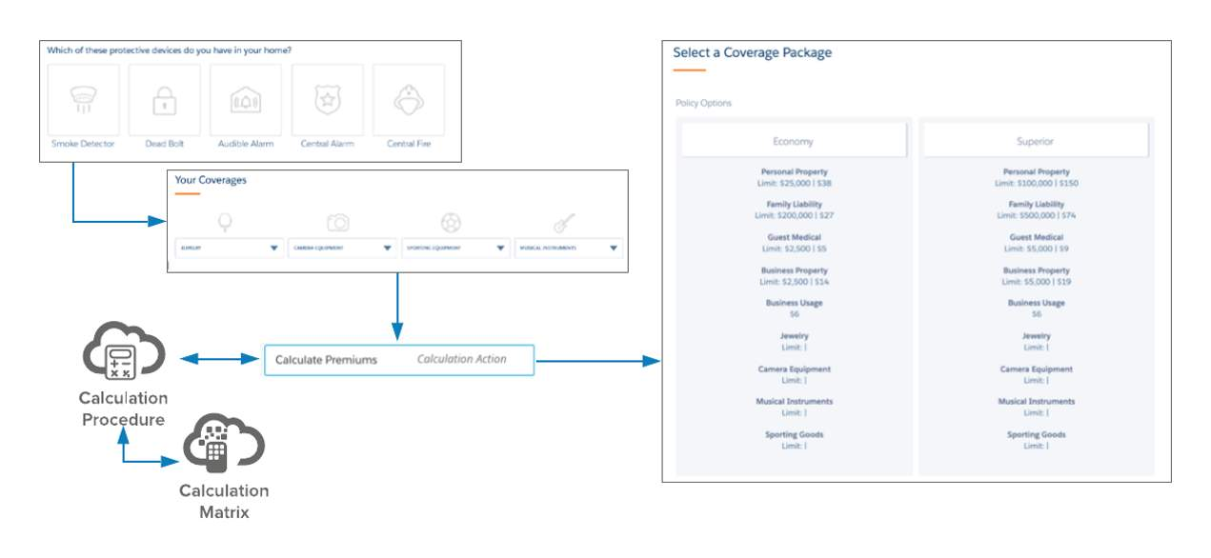
Calculation Matrix and Procedures
Notes:
Calculation Procedures allow complex math to be configured within OmniStudio. Sometimes you need more than a simple mathematical equation, and configuring Calculation Procedures enables you to run just this kind of comprehensive and detailed set of mathematical processing steps. To handle many factors, values, and calculations, a Calculation Procedure can call up one or more Calculation Matrices.
Calculation Matrices - These are simply lookup tables that take a unique input or set of inputs and return an output or set of outputs. Use a Calculation Matrix whenever you need to look up data. A Calculation Matrix adds to the functionality of OmniScripts and OmniStudio Integration Procedures. Using the Matrix Action you can call a Calculation Matrix from either tool.
There are three types of Calculation Matrices, and their uses vary.
Standard Calculation Matrix: Used when your matrix doesn't need to be a part of a group or versioned row by row.
Grouped Calculation Matrix: Used to group similar matrices with the same Input and Output headers together.
Row-Versioned Calculation Matrix: Used if you have a matrix with many rows and may need to change small portions of the data at a time. Each row has its own start date and time
Calculation Procedures
OmniStudio Calculation Procedures allow you to perform multiple mathematical operations and transformations at the same time. They take inputs as formatted JSON data and use lookup matrices, algebraic operations, and aggregation operations to calculate new data. They output specified data in formatted JSON and they can have conditional steps. Calculation Procedures are used to configure matrix lookups, set variables and constants, and perform basic math operations.
Several tools in OmniStudio can perform mathematical operations, including OmniStudio DataRaptor formulas, OmniScript Formula elements, and aggregate functions. So, why should you use Calculation Procedures? Here are some of the advantages:
Calculation Matrix integration
Built-in JSON array calculations and aggregation functions
Server-side execution
Time-based execution (You can have multiple versions in place that automatically execute based on when the data call is made.)
Calculation Procedures can help guide a customer or agent through a series of questions and pull data from various sources. You can use Calculation Procedures to deliver quotes or determine eligibility for things such as the following.
An individual health insurance plan to a customer via a website
A term-life quote via an agent
A volume discount on an order
A permit or application fee
A person applying for benefits or services
When there are a number of factors, values, and calculations, a Calculation Procedure can call one or more Calculation Matrices.
How to Read a Calculation Procedure
When reading a Calculation Procedure, it’s important to know its five basic components, outlined here.
Required:
Variables and Constants: Used in calculation steps
Optional:
Calculation Steps: Matrix and Lookup
Aggregation Steps: Allow you to use data from an array input where the calculations are run on each element separately
Preprocessor Class: Apex classes used to manipulate the input of the calculation
Postprocessor Class: Apex classes used to manipulate the output of the calculation

Slide 36
IDX Workbench
IDX Workbench is a desktop application that enables you to migrate OmniStudio DataPacks and Salesforce metadata.
Migrations are supported:
From one Vlocity org to another
From a Vlocity org to a Git repository
From a Git repository to a Vlocity org
From the Vlocity Process Library to a Vlocity org
From a JSON file to a Git repository or a Vlocity org
Components are packaged as DataPacks, which are optimized for source control and deployment to other orgs. For example, you can develop apps on a dedicated development org, then use IDX Workbench to deploy them to a QA org until they’re ready for use in production, and then deploy from your QA org to production orgs.
When you choose a component for migration, IDX Workbench ensures that its dependent components are included. For example, if you migrate an OmniScript that requires a DataRaptor, that DataRaptor is packaged for migration with the OmniScript.
In IDX Workbench, you define the source org or repository, the target org or repository, and the components to be migrated. You must create this definition before you can perform a migration. Migration is one way, from source to target. Source components overwrite target components of the same name and type.
Notes:
Download from https://drive.google.com/file/d/1t9L9VvJo1sIlN9e9pchFXVafxVl5DEBh/view?usp=sharing

Slide 37
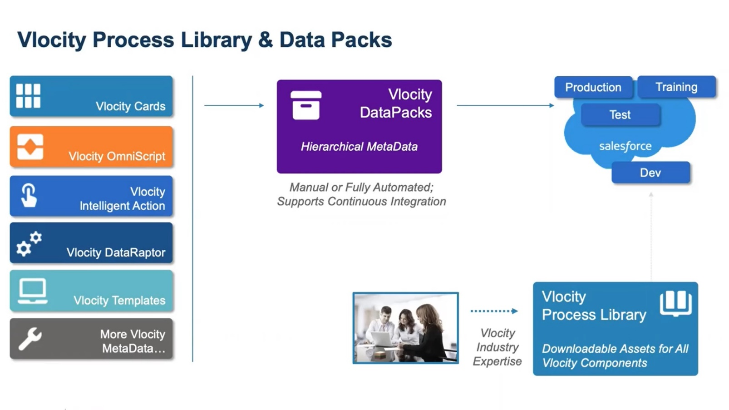
Vlocity Industry Process Library and Data Packs
Notes:
Vlocity Industry Process Library (VPL)
Install pre-built business processes from the Vlocity Industry Process Library in your org and tweak it as needed using Vlocity's configuration tools. so you can get a solution up and running faster.
The Vlocity Industry Process Library is a collection of pre-built, industry-specific process components that you can customize for your business needs without writing code. Process components are organized under each industry. You will only see the processes that pertain to your industry.
A Vlocity DataPack is a collection of Vlocity components and related functionality that we can package for quick migration from one org to another. You export a datapack from one org and then import it into another.

Slide 38
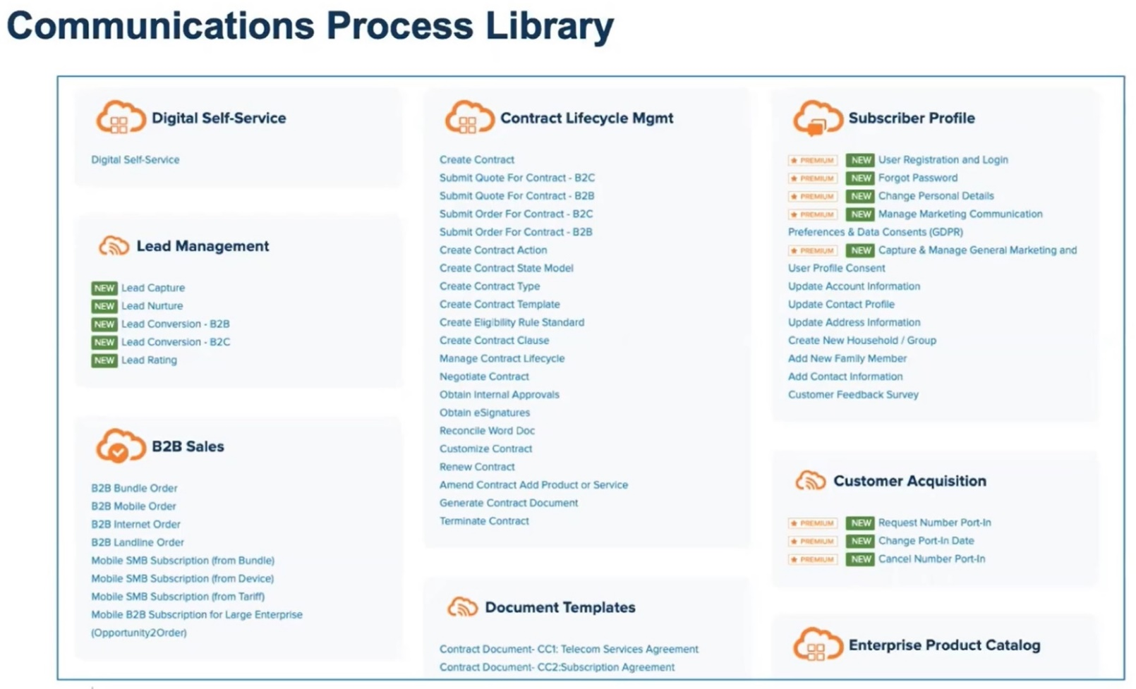
Vlocity Industry Process Library and Data Packs (Cont..)
Notes:
This is an example of a Communications Process Library.

Slide 39
Post Training
Support
Upon Training Completion we will continue to provide support for the next 10 days on any queries raised via email to the trainer (rajav@ideahelix.com). The Training team will assist in completing the Lab Exercises given during the training till end of support.
The support team will constantly ensure the assignments are completed on time and the participants are ready for the next session.
Exam Registration
Kindly create a user login in the below website and register for the “Salesforce Certified OmniStudio Developer (WI22)” Exam.
https://www.webassessor.com/

Slide 40

Thank You

